Slide 1
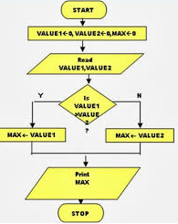
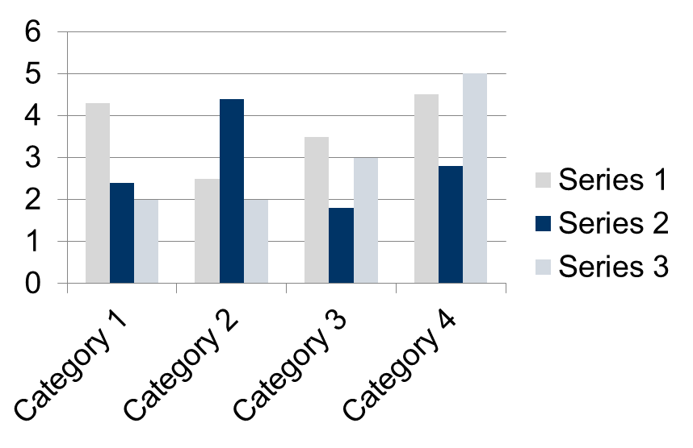
IT for Society Colloquium
Title
Author names, Contact details, affiliations
Poster Number
Introduction
Methods can be explained with flowchart or pseudo code . Your contribution should be highlighted.
Future Work
This template is designed to produce a A2 size poster in portrait or landscape orientation.
You can modify points or section size to be displayed as per your presentation need. The poster display should focus on:
Hypothesis or Objective
Methods or Mechanisms
Results or Outcomes
This section should include the problem statement or your research focus along with system block diagram and should answer the related research questions. This section can be about 200 words long.
Future Scope can be added in this section (Optional)
Further information such as where can people find out more information about your project. You can include your email, if possible a link to a website or PDF version of your poster.
Results / Findings
Results can be shown in form of tables or graphs or charts. Should be about 150 words.
Images of charts / tables/ graphs should be clear and readable.
TABLE SAMPLE
1998 | 1999 | 2000
2001 | 2002 | 2003
2004 | 2005 | 2006
Acknowledgments
A section for thanking people (Optional)
Bibliography / References
References are compulsory and should be in IEEE format
Methods / Procedures
About 150 words. Briefly describe the methods/procedures used and how they will help you find out about your hypothesis. Could use flow diagrams to help illustrate your procedures (this will help break up your text and make the poster look more interesting). Ensure you label diagrams if needed.
IEEE standard
Book,
[1] J. F. Curtis, (Ed.), Processes and Disorders of Human Comm-unication. New York: Harper and Row, 1978.
Journal Paper,
[2] J. Schroeterand M. M. Sondhi, “Techniques for estimating vocal-tract shapes from the speech signal,”IEEE Trans. Speech Audio Process., vol. 2, no. 1, pp. 133–150, 1994.
Proceeding paper,
[3] J. M. Pardo, “Vocal tract shape analysis for children,” in Proc. IEEE Int. Conf. Acoust., Speech, Signal Process., 1982, pp. 763–766.
Findings or Results of the algorithms used can be shown in this section
Conclusion / Discussions
About 250 words.
Without sounding like you are repeating yourself, start by reminding the viewer of your hypothesis and result.
Then discuss your results, why they are interesting, how the conclusion links back to your hypothesis and what could be the next step in this research in the future.
Figure 1 Flowchart 1

